Slide 1
Find song you want to edit:

Slide 2
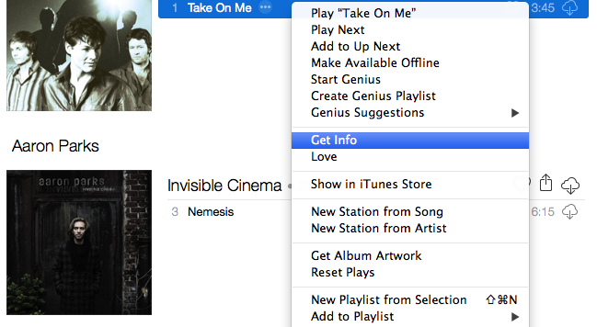
Select “Get Info”:

Slide 3
Select “Options” menu to find the start/stop dialog boxes:

Slide 4
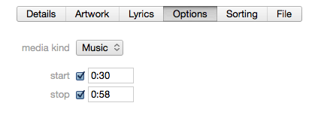
Check boxes and enter desired start/stop time:

Slide 5
Add edited song to new playlist:

Slide 6
Note that original time will remain next to song, but time will be adjusted when played:

