Slide 1
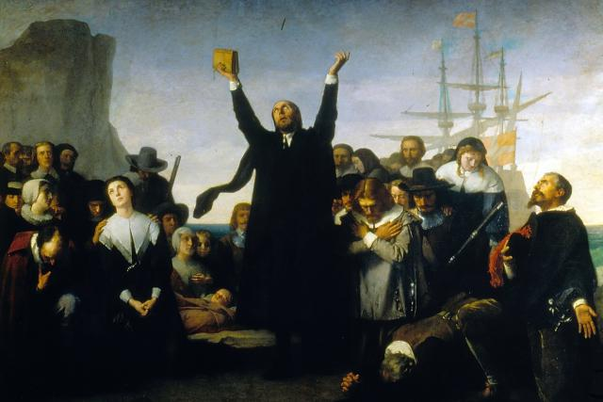
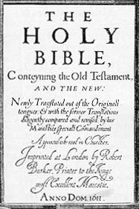
Tenets of Puritanism

Slide 2
Who were the Puritans?
The Puritans were a group of Protestants (Christians) who fled England in the early 1600s because of persecution for their religious beliefs. One faction of Puritans wanted to “purify” the Church of England by simplifying the services and abolishing the presence of statues and stained-glass windows in church structures.

Slide 3
Who were the Puritans?
The other faction of Puritans, the separatists, viewed the practices of the church as beyond modification and sought to separate from it to begin anew. The Puritans who established the Massachusetts Bay Colony in 1628 were non-separatists who hoped to purify the church.

Slide 4
What is a tenet?
ten·et
ˈtenət/
noun
noun: tenet; plural noun: tenets
a principle or belief, especially one of the main principles of a religion or philosophy.
“Bernie Sanders believes in the tenets of democratic socialism.”
synonyms: principle, belief, doctrine, precept, creed, credo, article of faith, axiom, dogma, canon.

Slide 5
Tenets of Puritanism
principles, beliefs, doctrines, precepts, creeds, credos, articles of faith, axioms, and dogmas.

Slide 6
The Supremacy of Divine Will
All natural phenomena are explained as being the will of God. All unnatural occurrences are attributed to witches, who are believed to be agents of the devil.

Slide 7
The Depravity of Man
Because Adam and Eve disobeyed God, all humans are naturally depraved—that is, morally and spiritually corrupted. Puritan ministers depict their congregations as being irretrievably damned and entirely sinful in nature.

Slide 8
The Doctrine of the Elect
After Adam sinned, a second covenant was made through the sacrifice of Christ, but only a few, the “elect,” would benefit. Puritans have no way of knowing whether or not they are of the elect.

Slide 9
Free Grace
Only the elect receive free grace (forgiveness). Free grace cannot be attained by good behavior because the elect are chosen only by God.

Slide 10
Predestination
God chooses who will be damned and who will not. God’s plan cannot be altered by human actions, and the Puritans have no certainty about God’s plan for them.

Slide 11
Theocratic Government
The government of Salem and other Puritan communities is controlled and made up of ministers and church members. The church and the civil government are the same. This form of government is called theocracy.

Slide 12
Work Ethic
Part of God’s punishment for Adam’s disobedience was to make humans work “by the sweat of their brow” in order to provide life’s basic necessities. Puritans also believed that only hard work brings success. This is often referred to as the Protestant Work Ethic.

Slide 13
Education
Puritans revered education, and school attendance was compulsory. They believed knowledge to be the best weapon against “that old deluder, Satan.” To that end, Harvard University was established by the Puritans in 1636.

